Slide 1
HOSPITAL APPOINTMENT SYSTEM
PRESENTED BY
ARCHANA R
III B.SC COMPUTER SCIENCE
GUIDED BY
Dr.P. KOKILA MSc.M.Phil.,Ph.D.

Slide 2
agenda
ABSTRACT
OBJECTIVE
HARDWARE SPECIFICATION
SOFTWARE SPECIFICATION
EXITING SYSTEM
PROPOSED SYSTEM
MODULES
DATA FLOW DIAGRAM.
TABLES
FORM DESIGN
CONCLUSION

Slide 3
ABSTRACT
A hospital appointment management system project is that for communicating between the patients and nurse, the patient can easily find about the hospital details and etc.… In this hospital management system first, the patient should have an entry with by using mobile number, if the patient has to be check first time the patient call be called new patient. Every patient record will be maintained by the hospital software. Also, we give an appointment to the doctors with patient needed. Then we can be calculated daily hospital bill by using this software. Which is a very long-term project we have to take only some basic thing module.

Slide 4
OBJECTIVES
The main of project on hospital appointment is to manage the details of doctor and patients.
The purpose of the project is to build an application program to reduce the manual work for managing the doctor, appointment, doctor fees, patient.
It tracks all the details about the patient booking, doctor schedule.

Slide 5
HARDWARE SPECFICATION
Processor : P 4 700 GHz.
RAM : 4 GB RAM
Hard Disk Drive : 180 GB

Slide 6
SOFTWARE SPECIFICATION
Operating System : Windows 7/8/10
Front End : PYTHON
Back End : MYSQL

Slide 7
EXISTING SYSTEM
The existing System provides basic functionality needed to be handled in a hospital management environment. There is no intelligence of a software in such cases. In the existing system all the patient details, Doctor availability details and medicines prescribed by the doctor is maintained by the receptionist. If a patient has to be admitted, we need to check the availability of that particular doctor which consumes a lot of time if done manually
DISADVANTAGES
It is very difficult task to maintain all the details regarding the patient as far as existing system is considered
There are also many loop holes when we look at the security of the systems
Also there is no proper search technique to check persons information.

Slide 8
PROPOSED SYSTEM
In our proposed system, we are going to provide solutions to all the above mentioned problems. The System includes a web application accompanied by a microcontroller based hardware model. The web application serves patients with following facilities Online appointment booking.
ADVANTAGES
Our system ensures retention of patient’s data and its security.
All the process has been handling into the single application.

Slide 9
Modules
Patient Registration
In this module is used to the hospital receptionist enters the login and collect the information from the patient details and save it. After the patient registration only the patient having an appointment for doctors.
Doctor Registration
In the module is used to the hospital receptionist enter the doctors details and give the username and password to the doctors. Doctors are using this username and password to login and know about his/her appointment details.

Slide 10
Doctor Appointment
This module is used to the hospital receptionist have to give an appointment to a patient based on doctors. The user selects the doctor and give an appointment, finally the doctor will check what are the patients are admitted by them self.
Appointment Patient details
In this module have to clarify the appointment patient details, every doctors has been enter the login and view their admitted patient who are all admitted and view their patient details also.

Slide 11

Data Flow Diagram
Level 0 :

Slide 12
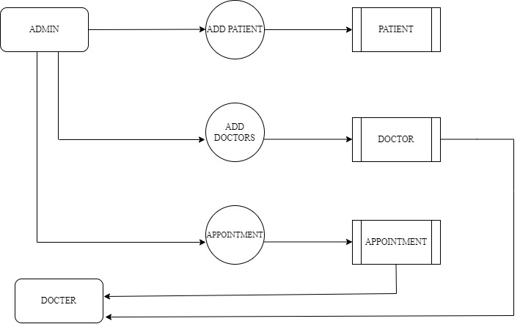
Level 1:

Slide 13
TABLES: ADMIN
FIELD | DATA TYPE | SIZE | CONSTRAINT
Adminid | Int | 10 | Primary key
Username | Varchar | 20 | Not null
Password | Varchar | 10 | Not null

Slide 14
Patient
FIELD | DATA TYPE | SIZE | CONSTRAINT
patient id | Int | 10 | Primary key
firstname | Varchar | 20 | Not null
last name | Varchar | 10 | Not null
Mobile | Number | 10 | Not null
Email | Varchar | 30 | Not null
Attender | Varchar | 20 | Not null
Emergency | Number | 10 | Not null

Slide 15
Doctor
FIELD | DATA TYPE | SIZE | CONSTRAINT
Doctor Id | Int | 10 | Primary key
doctor name | Varchar | 20 | Not null
Speciality | Varchar | 20 | Not null
qualification | Varchar | 10 | Not null
username | Varchar | 10 | Not null
password | Varchar | 10 | Not null

Slide 16
Appointment
FIELD | DATA TYPE | SIZE | CONSTRAINT
appointmentid | Int | 10 | Primary key
doctor id | Int | 10 | Foreign Key
Patient Id | Int | 10 | Foreign Key
Appointment Date | Date | 10 | Not null
Token | Int | 10 | Not null

Slide 17
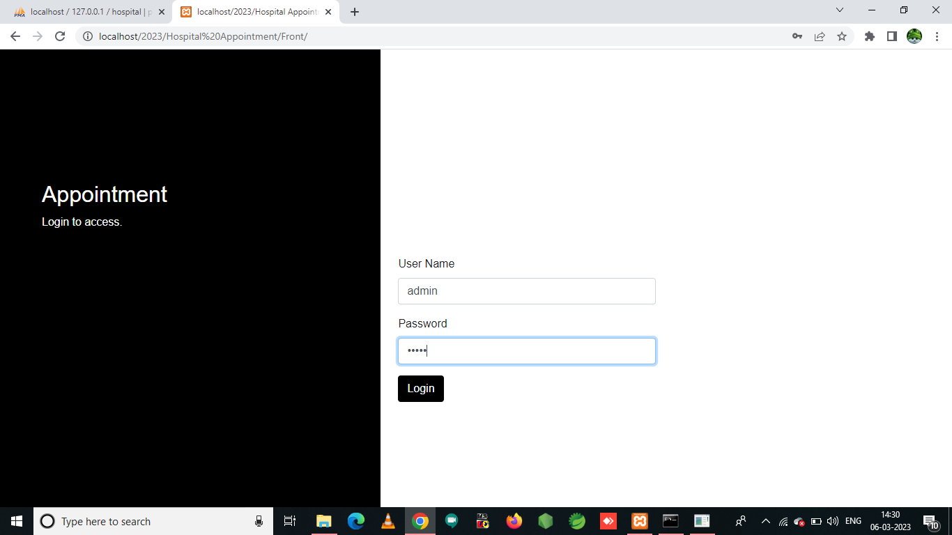
FORM DESIN: LOGIN PAGE

Slide 18
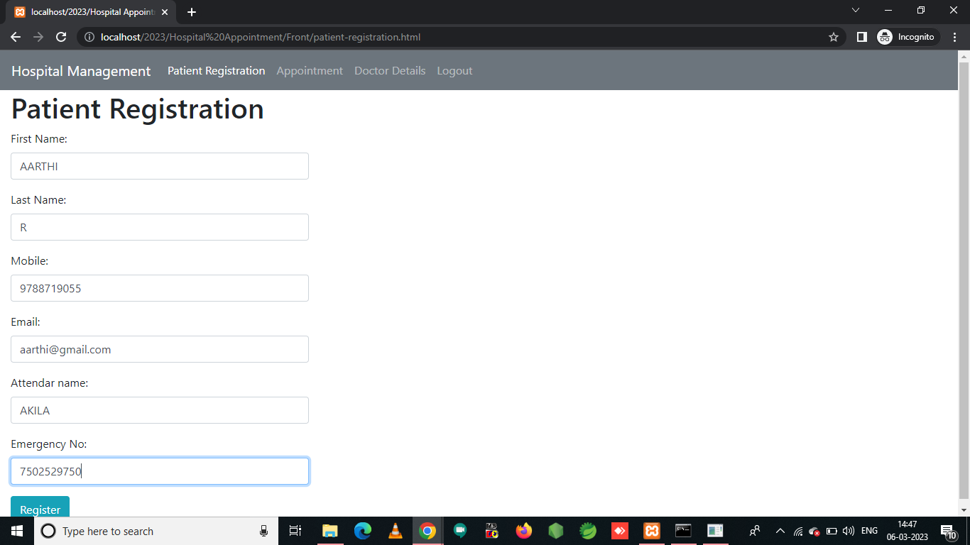
PATIENT REGISTRATION

Slide 19
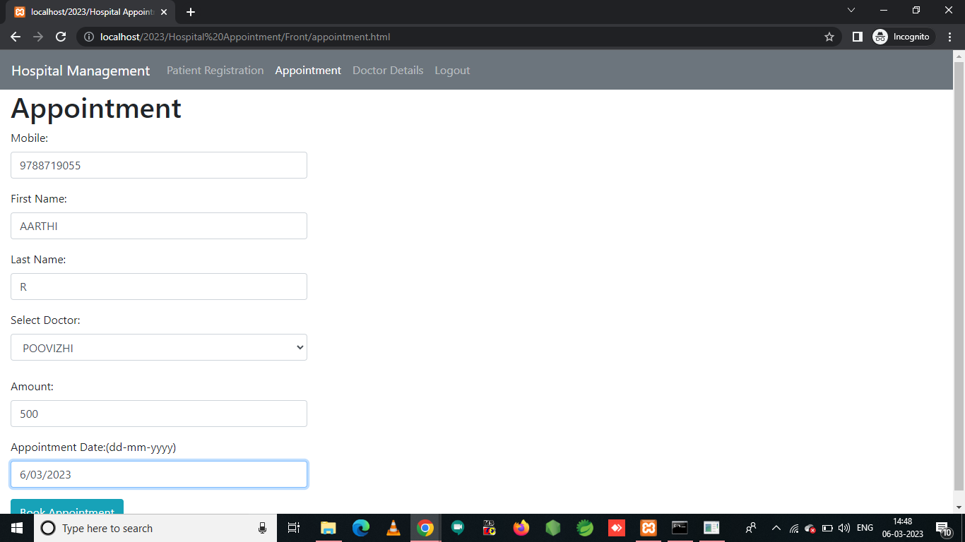
APPOINTMENT

Slide 20
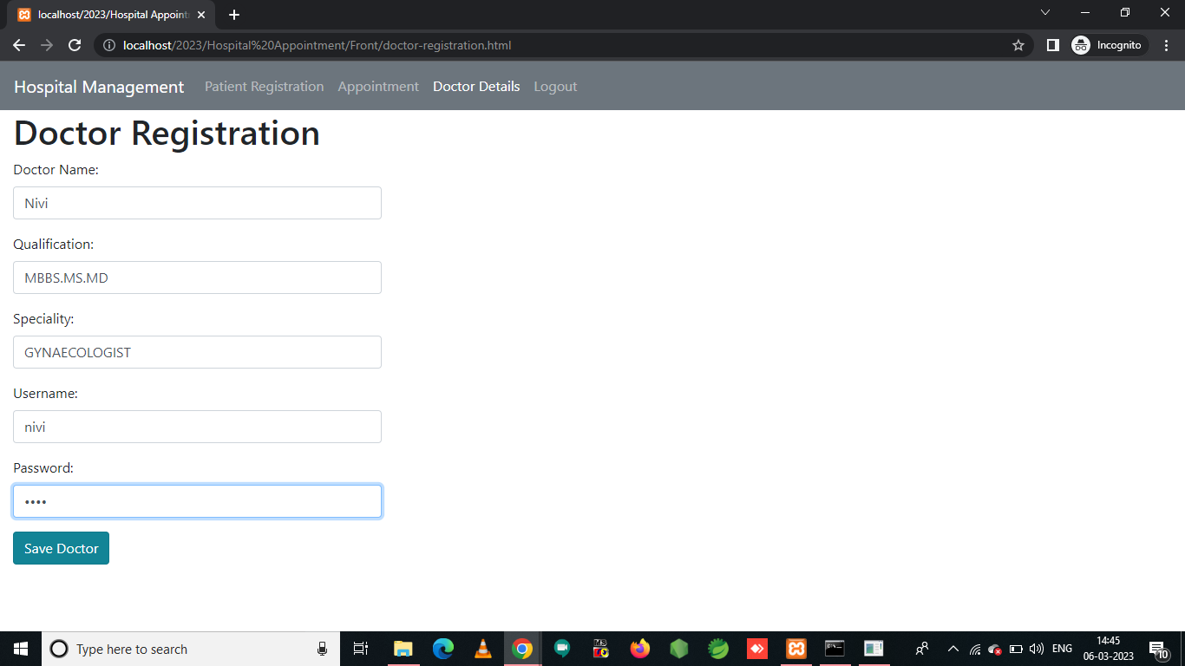
DOCTOR REGISTRATION

Slide 21
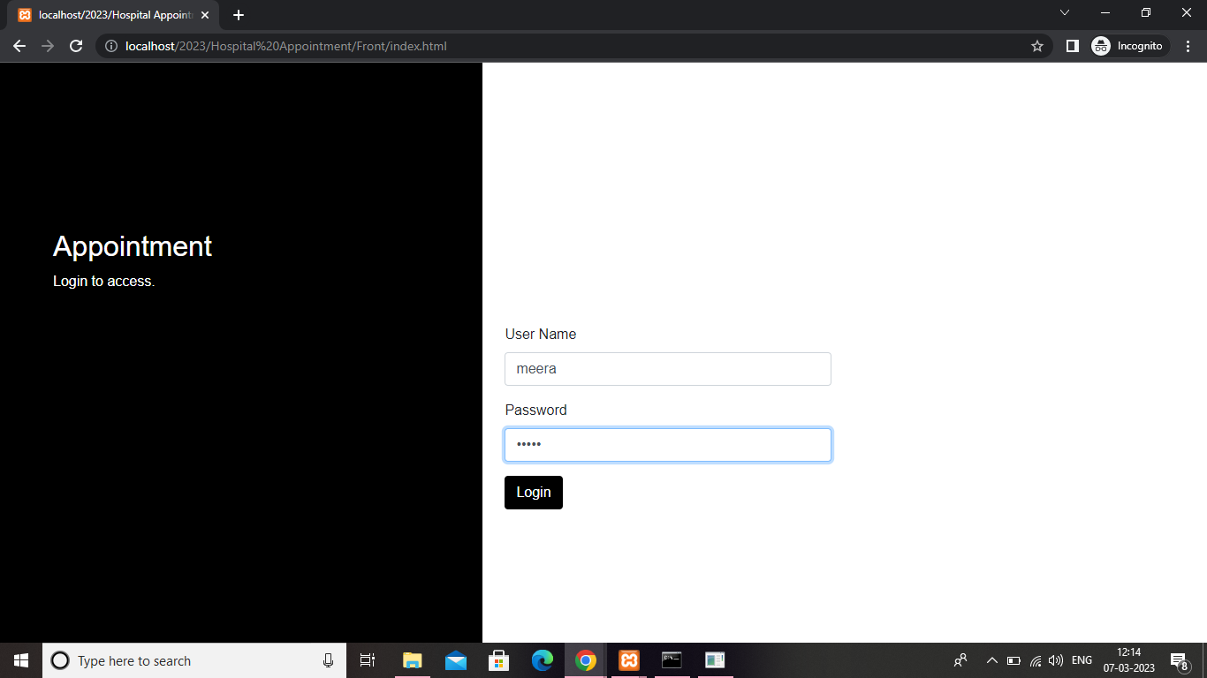
Doctor login

Slide 22
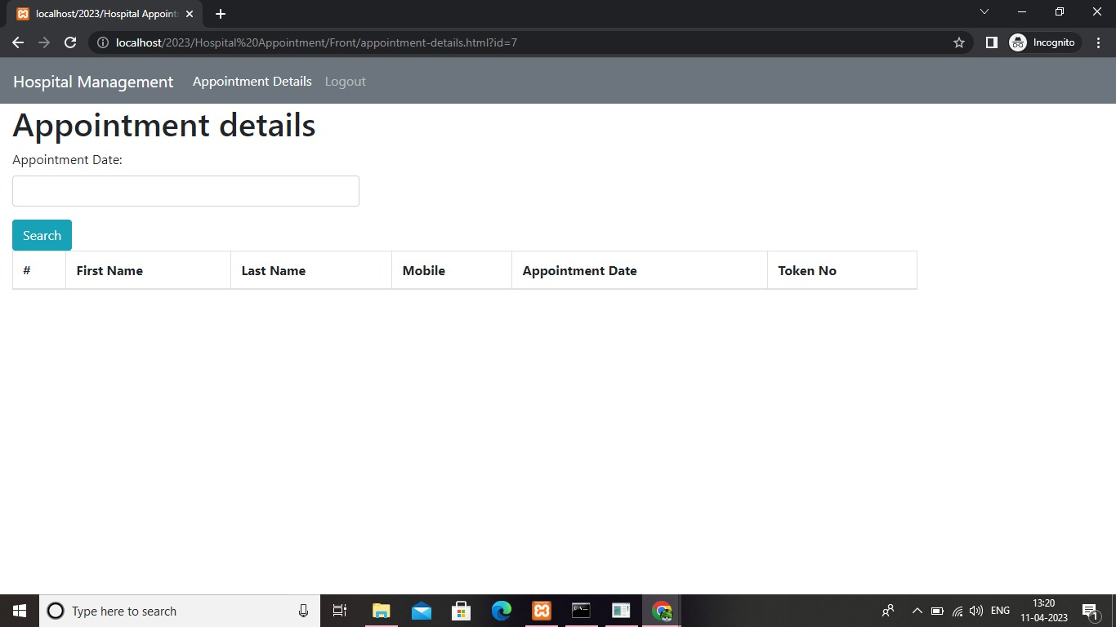
Appointment details

Slide 23
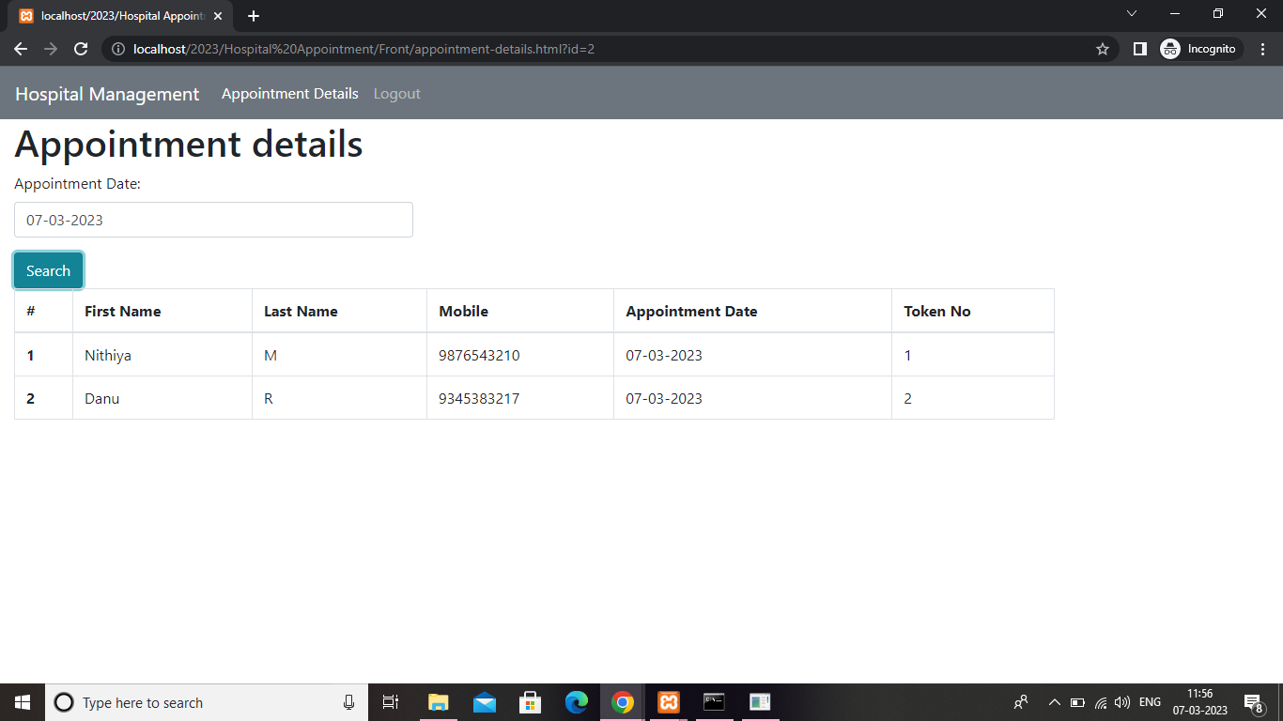

Slide 24
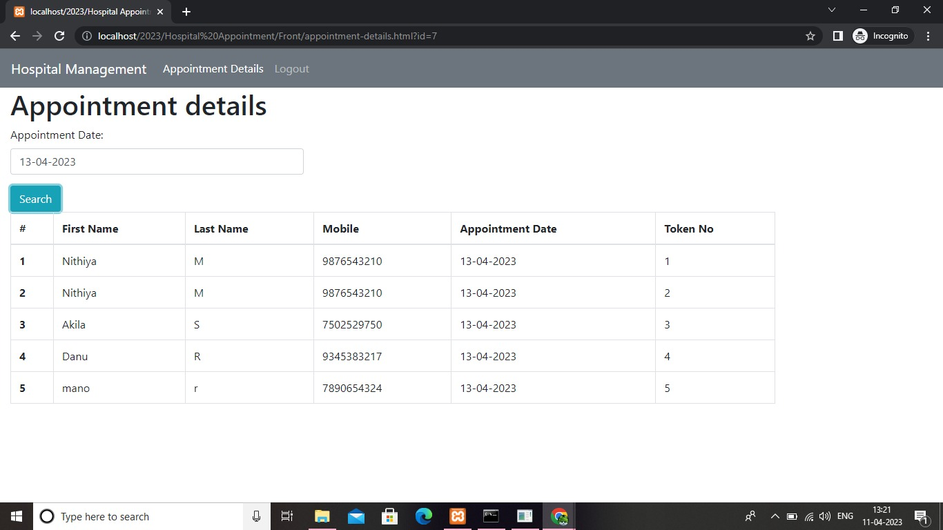
Thank You

Slide 25
CONCLUSION
In conclusion, hospital appointment systems are powerful tools that help hospital administrators manage and organize their outpatient operations.
These systems provide several benefits, including increased efficiency, reduced waiting times, enhanced patient satisfaction, and real-time data insights.
Hospital administrators can leverage these benefits to improve patient care, optimize hospital operations, and enhance hospital reputation.
These systems also improve communication and collaboration between different departments and staff members, allowing for seamless coordination of efforts.
This leads to better patient outcomes, improved patient satisfaction, and enhanced hospital reputation.

Slide 26
THANK YOU

